Slide 1

SENTIMENT ANALYSIS
ON YELP DATA
York Fang, Adwait Toro, Sonal Mendiratta, Yeran Liu, Kevin Seng

Slide 2
CONTENT
About Yelp Data
Exploratory Data Analysis
Sentiment Analysis
Packages: TextBlob and Vader
Models : Logistic Regression, Random Forest and SVM
Learnings
Notes:
Walk you all through our slides
Yelp Data and EDA: Kevin
Sentiment Analysis: York, Sonal, and Adwait
Learnings: Adwait

Slide 3
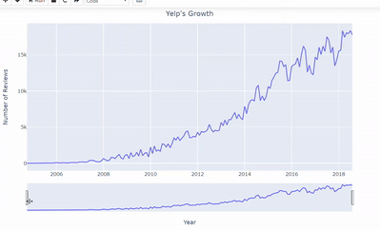
ABOUT YELP
Founded in 2004 in San Francisco by 2 former Paypal employees
Provides businesses of all sizes with a range of free and paid services that help them engage with consumers
One-stop local platform for consumers to discover, connect and transact with local businesses of all sizes
Recent product innovation includes:
Reservations and waitlist
Food Deliveries
Business-owner monetization
Yelp has seen strong user review growth over the years
Notes:
Yelp is an online community where users could share recommendations for local services
Founded by 2 Paypal Employees
Interesting fact is that Steve Jobs persuaded the founders to turn an acquisition offer by Google
Great growth as illustrated by this graph

Slide 4




ABOUT THE DATA
6,685,900 Reviews
192,609 Businesses
(Restaurants have the highest representation)
20 + Business Attributes
10 Metropolitan Areas
4
Notes:
Since 2008, Yelp has openly made five datasets available to the public: Reviews, Businesses, Tips, Image, and Check-in. These datasets only contain a sample amount of their full collection of data. For our analysis, we are only focusing on the review and business dataset. The review dataset contains over 6 millions unique reviews and the business contains over 190 thousand unique businesses.

Slide 5
EXPLORATORY DATA ANALYSIS

Slide 6
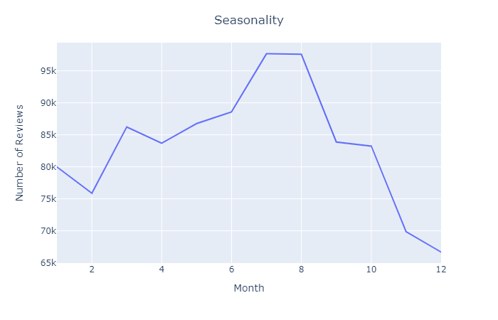
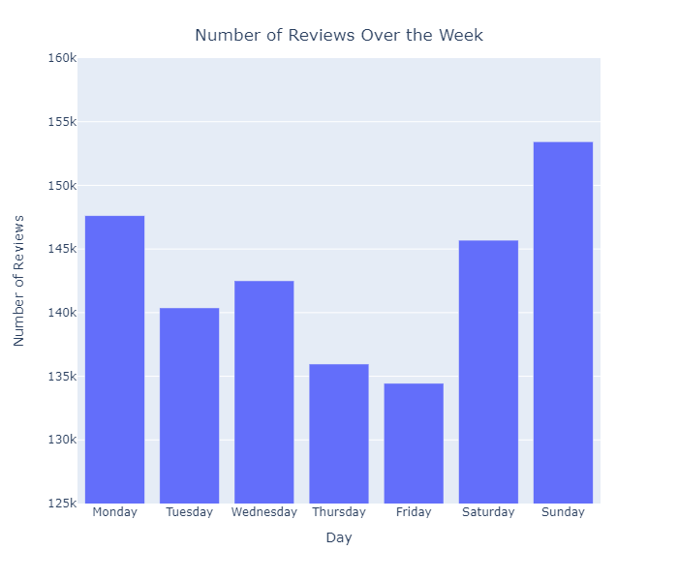
USER BEHAVIOR
Notes:
From the review dataset, we were able to analyze users’ behavior on when they like to submit reviews. We narrow the date columns of the dataset to months and weeks. These two graphs show that amount of reviews are affected by different seasons. In the summer months, where consumers are more likely to travel and weather is more favorable, consumers enter more reviews compare to the winter months. Additionally, consumers are more likely to enter reviews during the weekends, most likely because they have more leisure time.

Slide 7
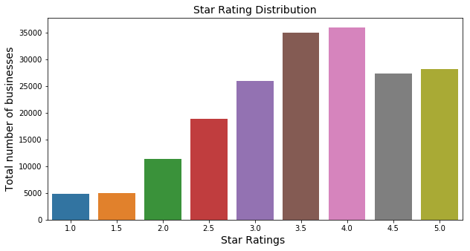
STAR RATINGS DISTRIBUTION
BY RESTAURANT COUNT
Maximum number of restaurants had an average of 4 star rating
Notes:
4 star ratings has the most number of restaurant, followed very close by 3.5 star ratings. Among those restaurant, AZ has the most restaurants and most number of 5 star ratings count

Slide 8
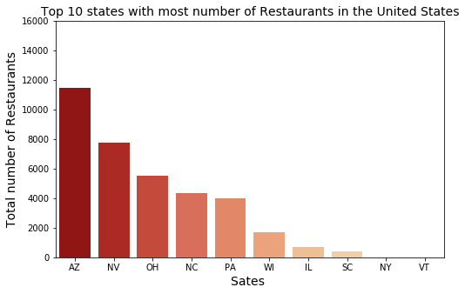
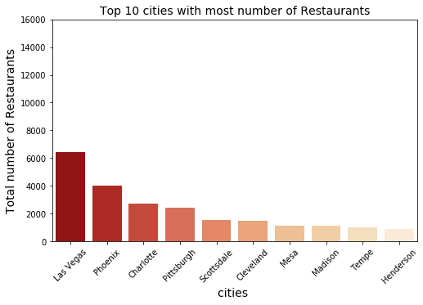
TOP 10 STATES IN USA
WITH MOST RESTAURANTS
Of all states, Arizona has the most number of restaurants in the United States
TOP 10 CITIES IN USA
WITH MOST RESTAURANTS
Of all cities, Las Vegas has the most number of restaurants in the United States
Notes:
then we can look at even more detailed that we break down the restaurant distribution from the overall dataset to USA only, from the overall dataset, we can tell that Ontario state in canada has the most of restaurant and followed by Arizona and then Nevada from USA, in the city side, the city Toronto has the most of restaurants then followed by Las vegas, in the United States, Top 3 number of restaurant of states are AZ, NV and ohio, top 3 cities are Las Vegas, phoenix and Charlotte

Slide 9
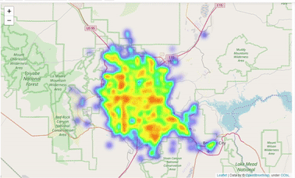
HEATMAP OF NEVADA
Notes:
Nevada had the largest representation in our dataset. We wanted to visualize the activity in this state with a heatmap. After filtering the dataset to only include Nevada businesses, we group latitude and longitude and the number of businesses in each area. From the heatmaps, we can see that most of user reviews are from the Las Vegas Area, primarily in the downtown area.

Slide 10
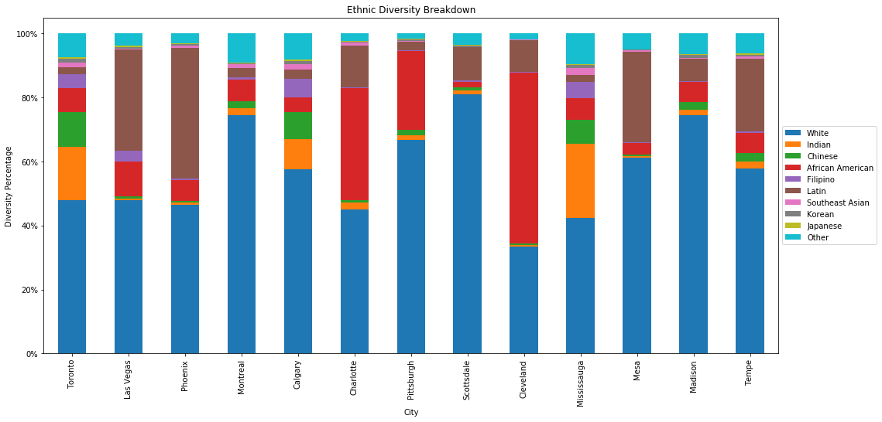
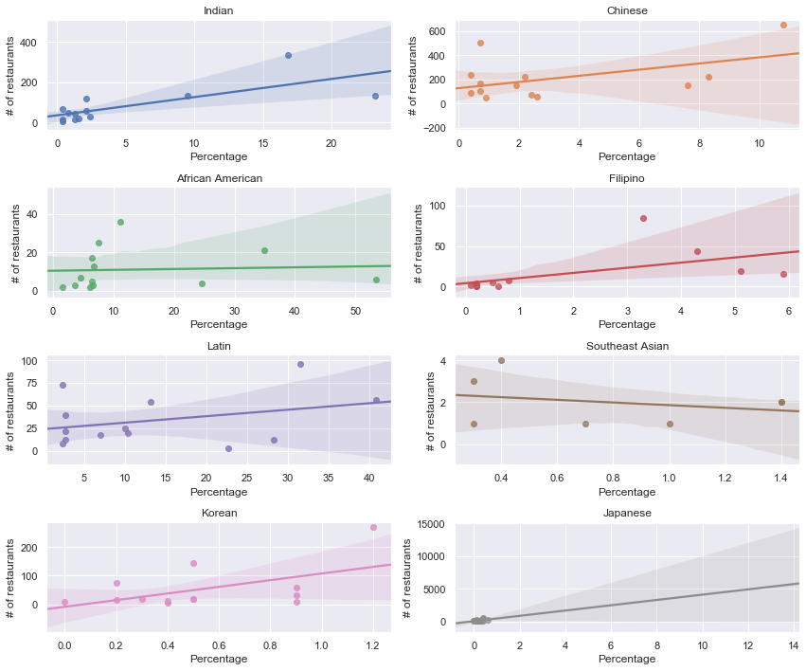
ETHNIC FOOD CUISINE BREAKDOWN
More diversity in the bigger Canadian metropolitan cities
Slight positive correlation between number of restaurants and percentage of different ethnic groups.

Slide 11
SENTIMENT ANALYSIS

Slide 12



WHAT IS SENTIMENT ANALYSIS?
Definition:
the use of natural language processing, text analysis, computational linguistics, and biometrics to systematically identify, extract, quantify, and study affective states and subjective information
Uses:
social media monitoring, competitive research, customer service evaluation, market research

Slide 13
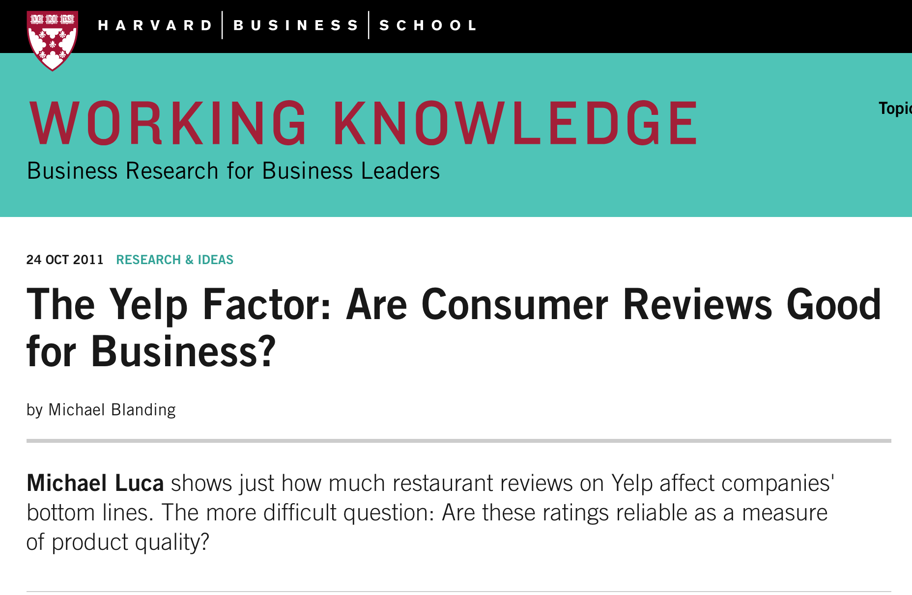
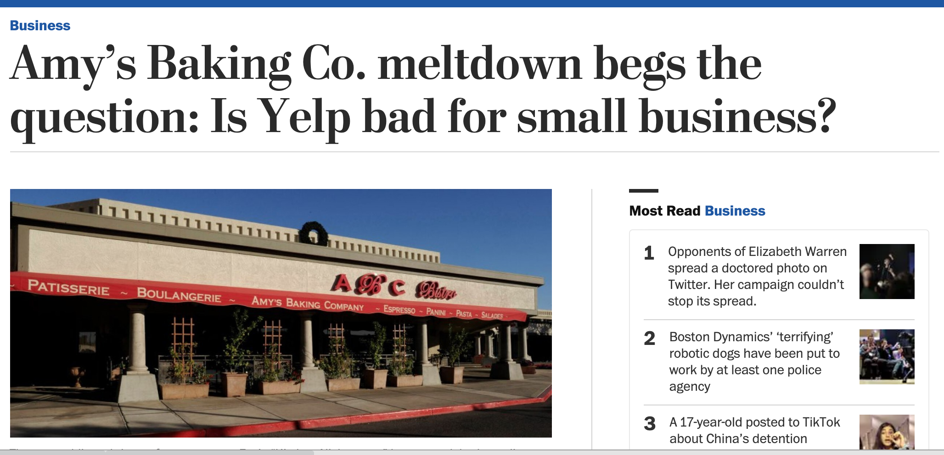
HOW MUCH POWER DOES A YELP REVIEW HAVE?
A LOT!
Notes:
Sources:
https://www.washingtonpost.com/business/amys-baking-co-meltdown-begs-the-question-is-yelp-bad-for-small-business/2013/05/17/9c07e1aa-beff-11e2-89c9-3be8095fe767_story.html
https://www.quora.com/How-much-does-one-bad-Yelp-review-affect-a-local-business
https://www.washingtonpost.com/business/technology/how-much-power-does-a-yelp-review-have/2013/05/22/6b8f961c-c210-11e2-8c3b-0b5e9247e8ca_story.html
https://hbswk.hbs.edu/item/the-yelp-factor-are-consumer-reviews-good-for-business

Slide 14
NLTK PACKAGES

Slide 15
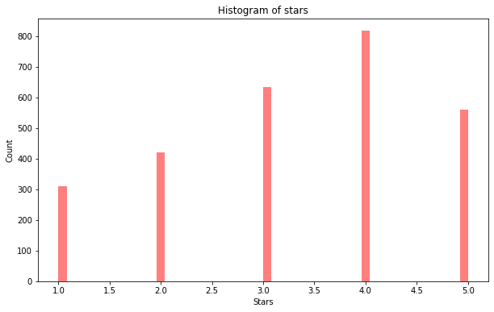
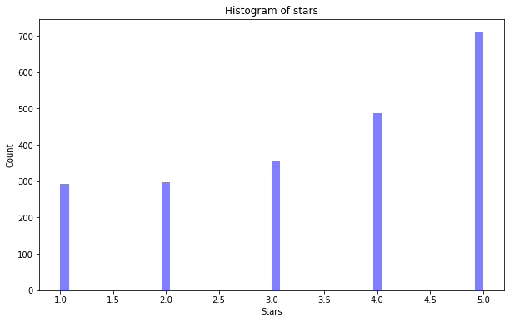
RESTAURANT COMPARISON
The buffet at Bellagio
Guy Fieri's Vegas Kitchen & Bar
Average rating: 3.3
Location: Las Vegas
Sample size: 2000+
Average rating: 3.5
Location: Las Vegas
Sample size: 2000+
Notes:
For our sentiment analysis, we want to compare 2 restaurants in the most reviewed state: Nevada. These 2 restaurants are comparable because we took similar sample size, the location and restaurant category is the same.

Slide 16
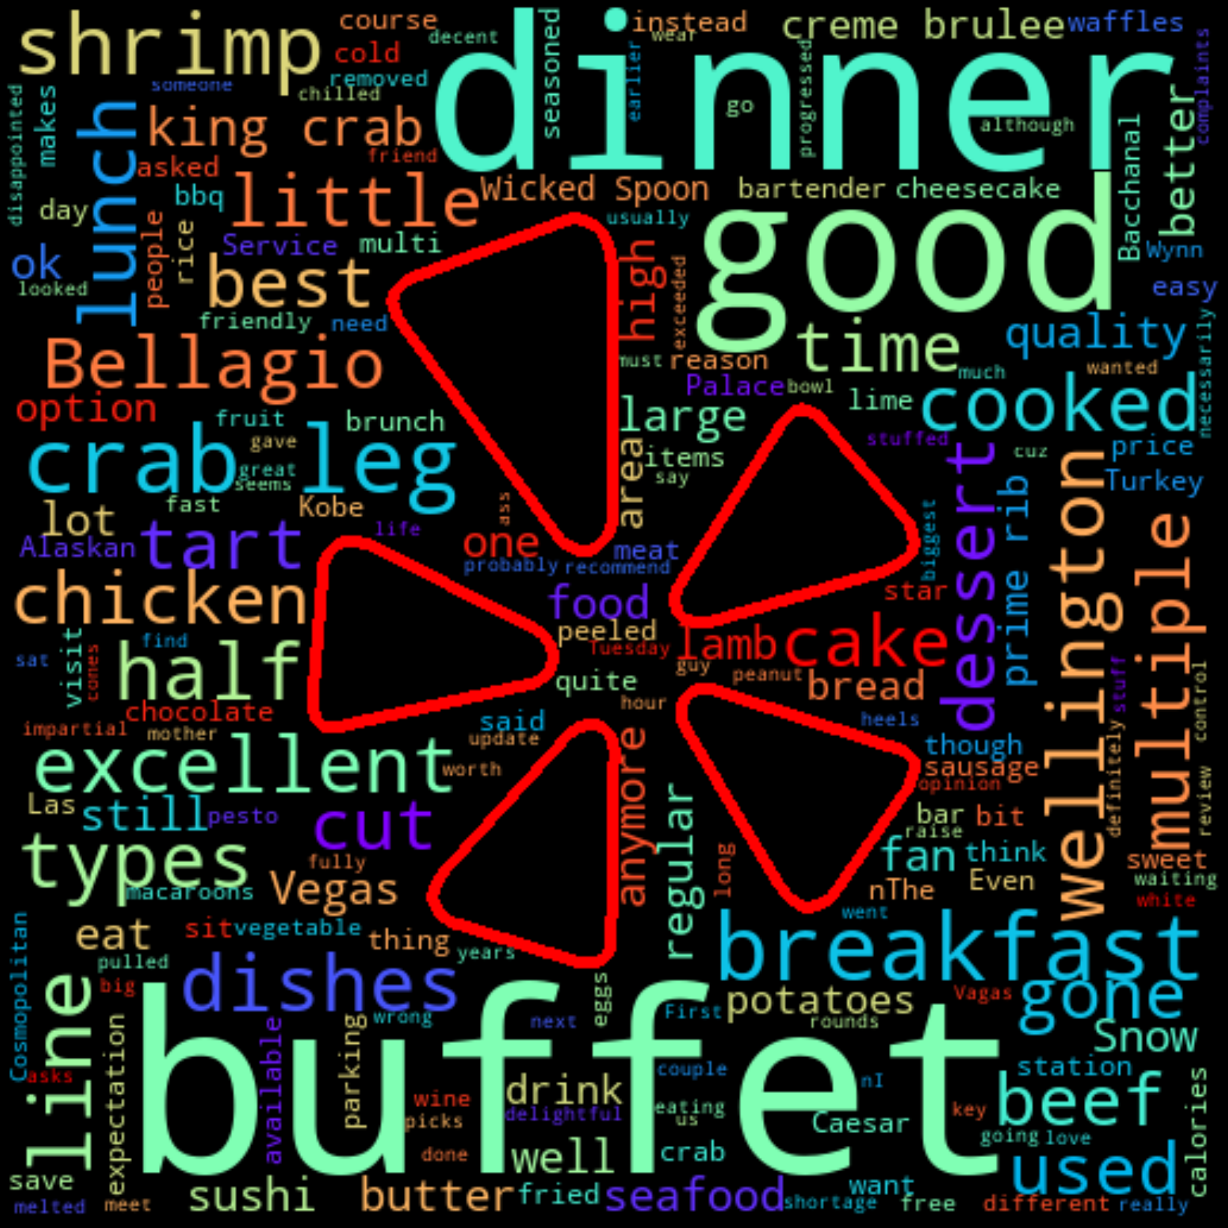
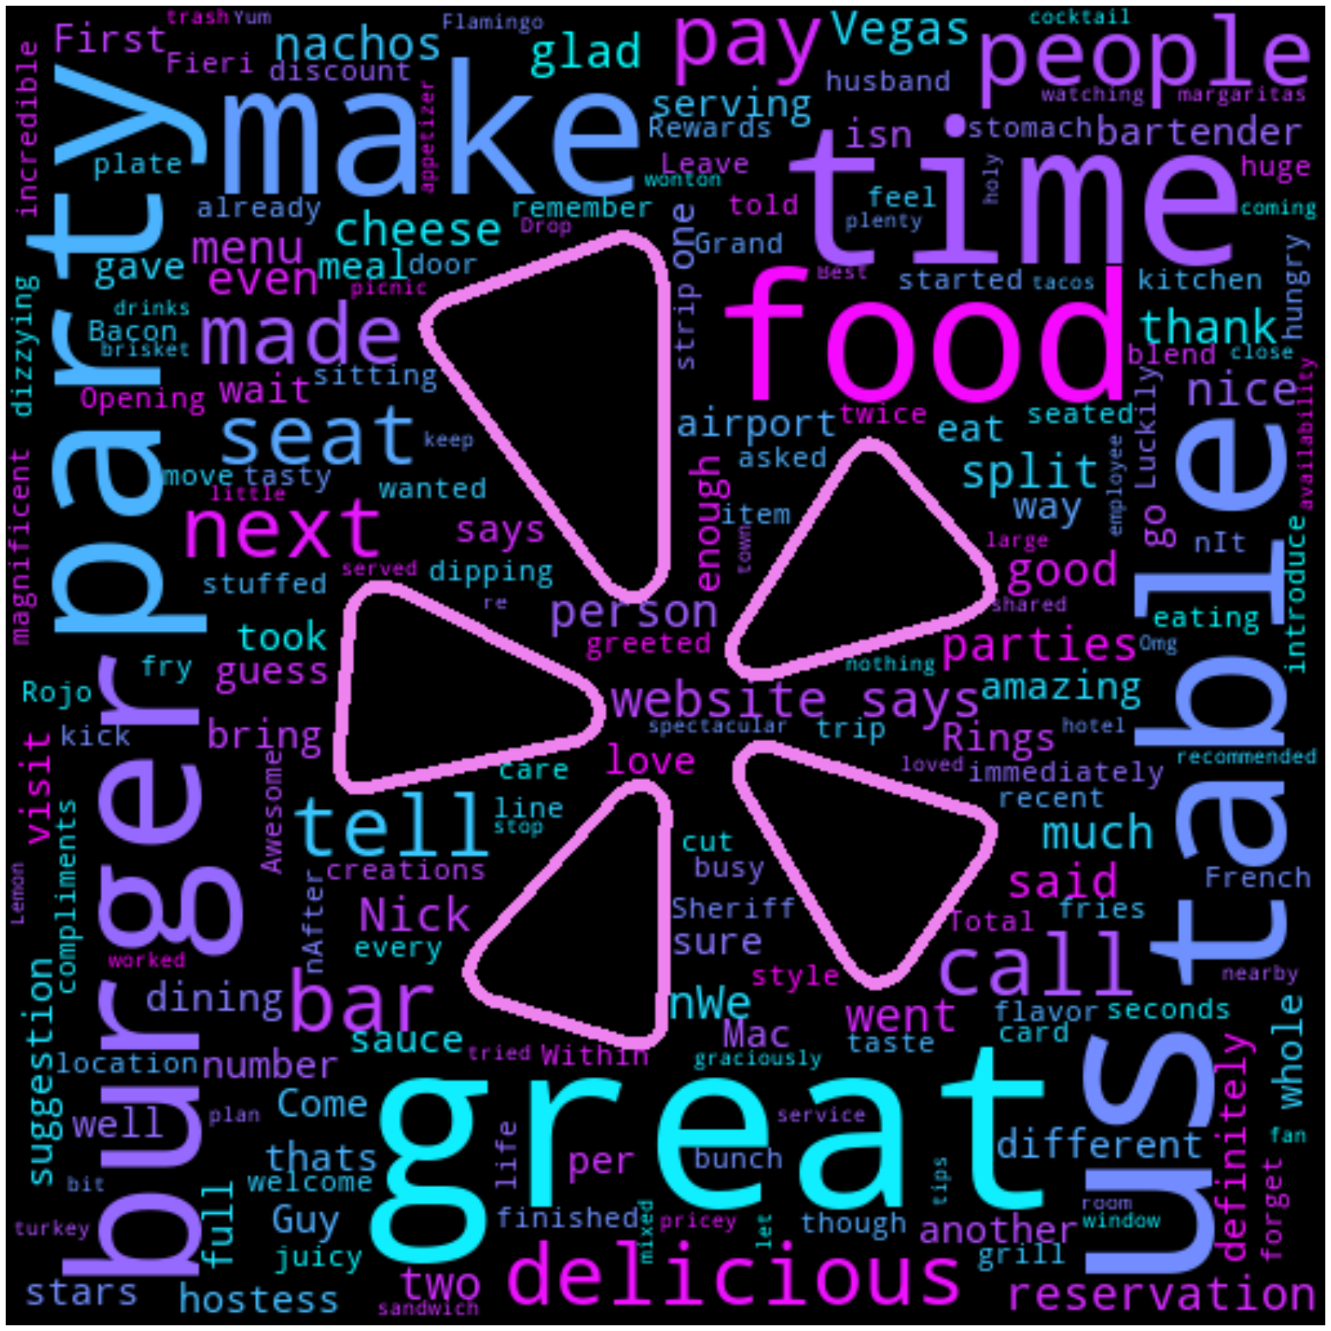
WORD CLOUD

Slide 17

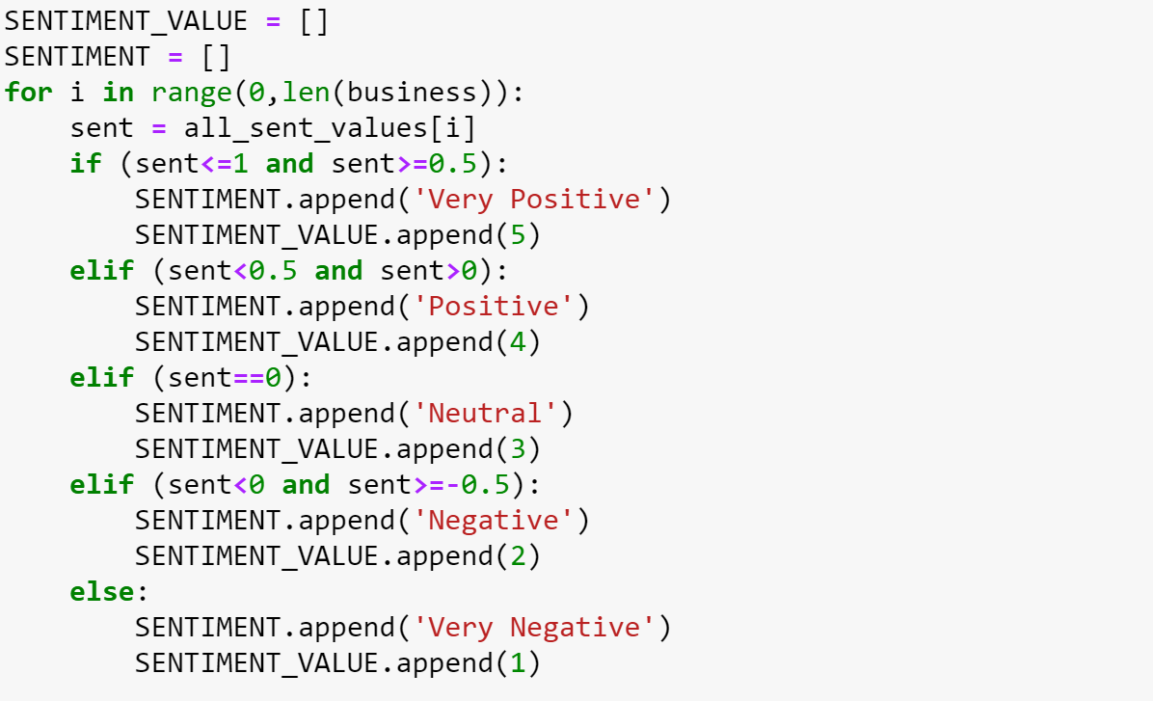

NLTK PACKAGES
TextBlob
Vader
Calculate full review based on all the words
Returns polarity and subjectivity
Polarity ranges from -1 (most negative) to 1 (most positive)
Subjectivity ranges from 0 (least subjective) to 1 (most subjective)
Calculate sentiment score based on the whole review
Returns sentiment dictionary
(pos, neu, neg, compound)
Range from -1 (most negative) to 1 (most positive)
Notes:
To begin with our sentiment analysis, we focus on one restaurant and try different existing packages in Python.

Slide 18
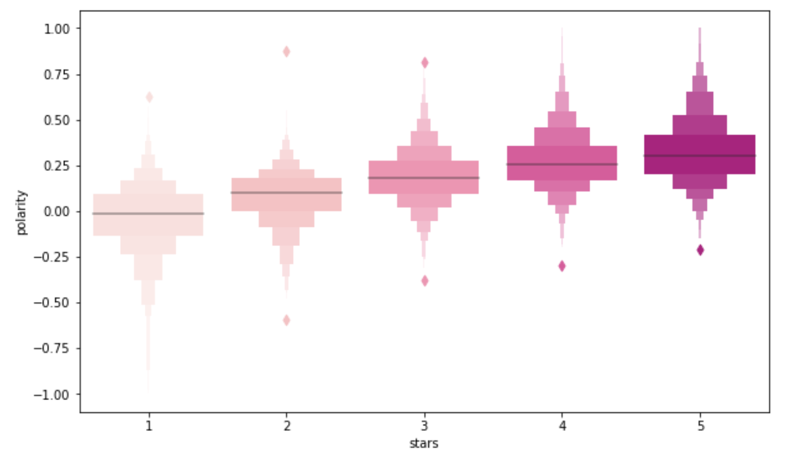
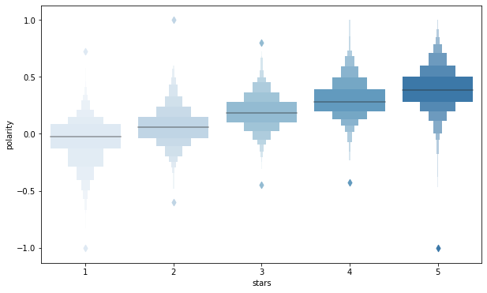
RATING POLARITY
The Buffet at Bellagio
Guy Fieri's Vegas Kitchen & Bar
Notes:
Key takeaway: Although the average is increasing with star ratings, the TextBlob package shows a equal distribution throughout the ratings which shows abnormality

Slide 19
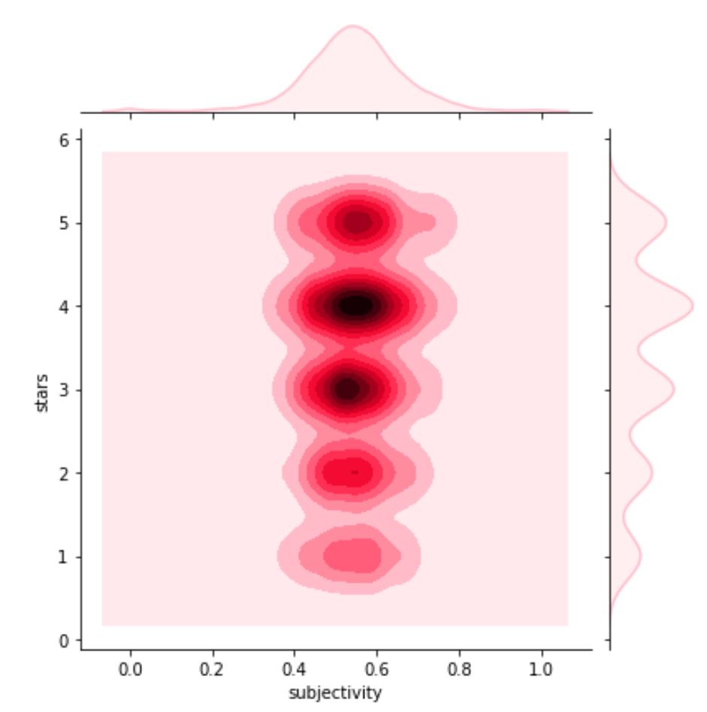
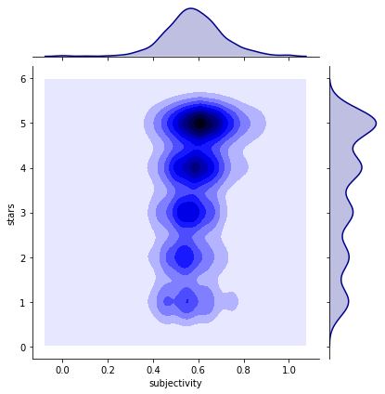
RATING SUBJECTIVITY
The Buffet at Bellagio
Guy Fieri's Vegas Kitchen & Bar
Notes:
Buffet at bellagio ‘s ratings in 3 and 4 shows most distribution of subjectivity meaning people would be more likely to give constructive criticism. While the other shows more subjectivity in 4 and 5 star ratings.

Slide 20
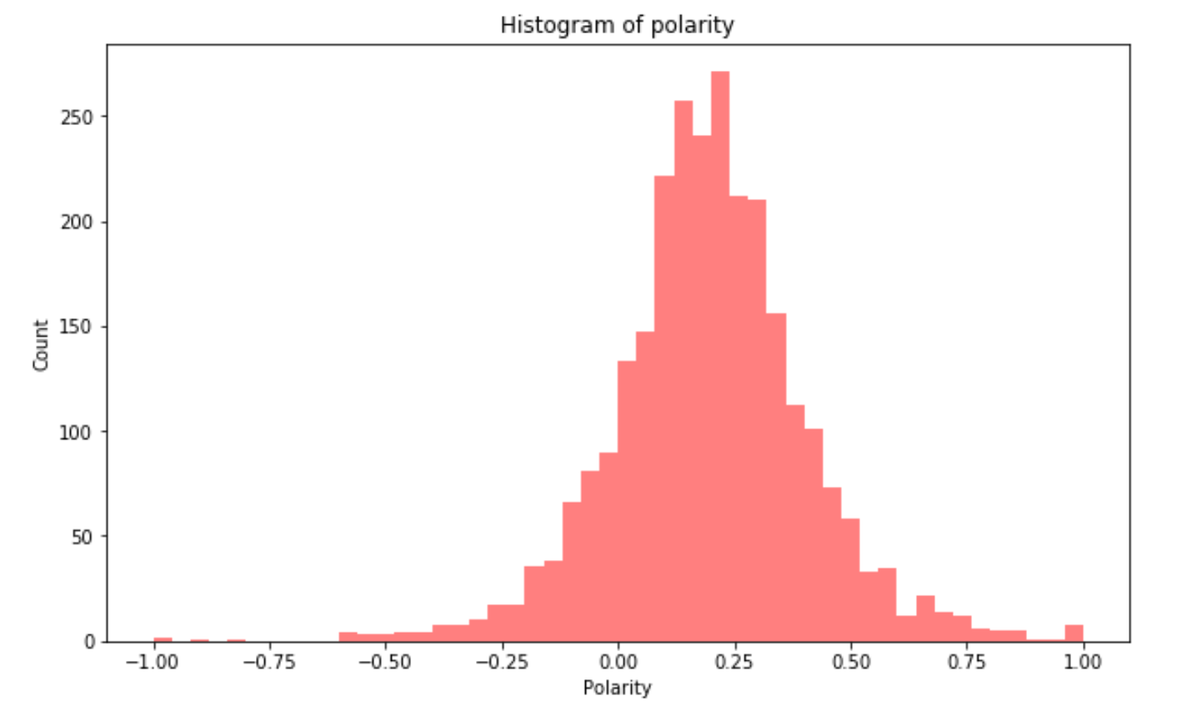
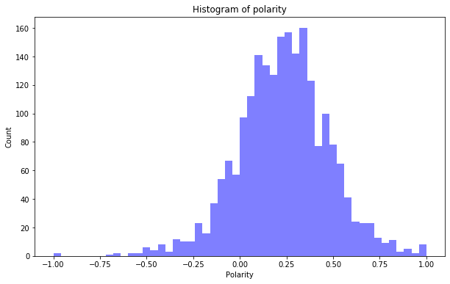
TEXTBLOB POLARITY DISTRIBUTION
The Buffet at Bellagio
Guy Fieri's Vegas Kitchen & Bar

Slide 21
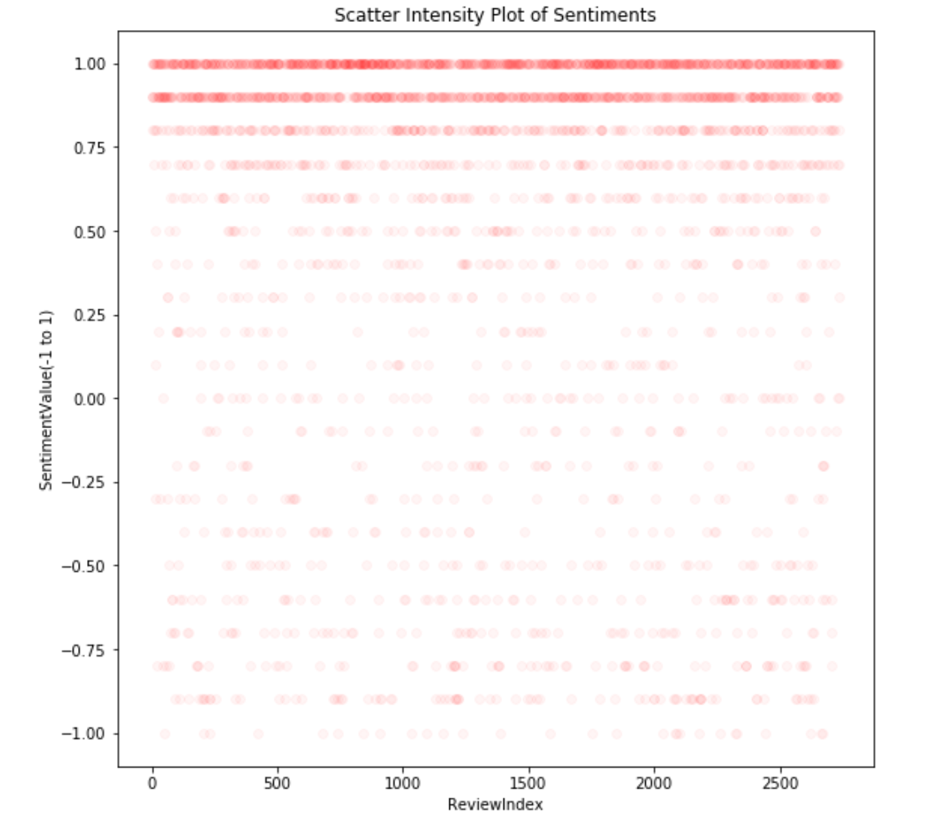
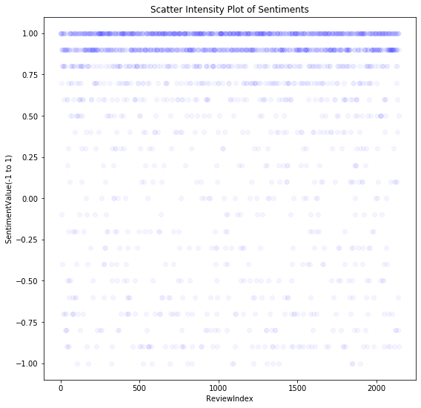
VADER SENTIMENT DISTRIBUTION
Notes:
After comparing both models, we could see the sentiment distribution

Slide 22
MODELS

Slide 23
INTRODUCTION TO TERMINOLOGIES
FEATURE REPRESENTATION
STOP WORDS REMOVAL
STEMMING
WITH STOP WORDS | WITHOUT STOP WORDS
Growing up with hearing loss | Growing hearing loss
PRESENTATION | PRESENTING | PRESENTS | PRESENTED
PRESENT
FEATURE ENGINEERING
UNIGRAM
UNIGRAM AND BIGRAM
I | HAVE | A | LOVELY | DOG
UNIGRAM | I | HAVE | A | LOVELY | DOG
BIGRAM | I HAVE | HAVE A | A LOVELY | LOVELYDOG
FEATURE WEIGHTING
TFIDF – words that are unique to a document would have higher weights compared to the words that are used commonly across documents
Binary – if a word is present in the document, the weight is ‘1’ else ‘0’
Count – weights equal to number of occurrences of a word
Notes:
After comparing both models, we could see the sentiment distribution

Slide 24
METHODOLOGIES
APPROACH
TEXT CLEANING
ANALYSIS
MODELS
Unigram
REMOVE STOPWORDS + STEMMING
TF-IDF
COUNT
BINARY
Logistic Regression
12 MODELS
Unigram + Bigram
1/0
Reviews
Random Forest
-1/0/1
REMOVE STOPWORDS,HASHTAGS, NUMBER, PUNCTUATION etc. + STEMMING
TF-IDF
BoW
16 MODELS
1/0
SVM
-1/0/1

Slide 25
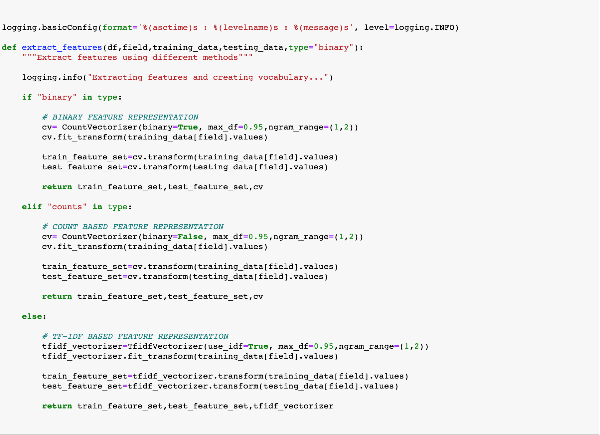
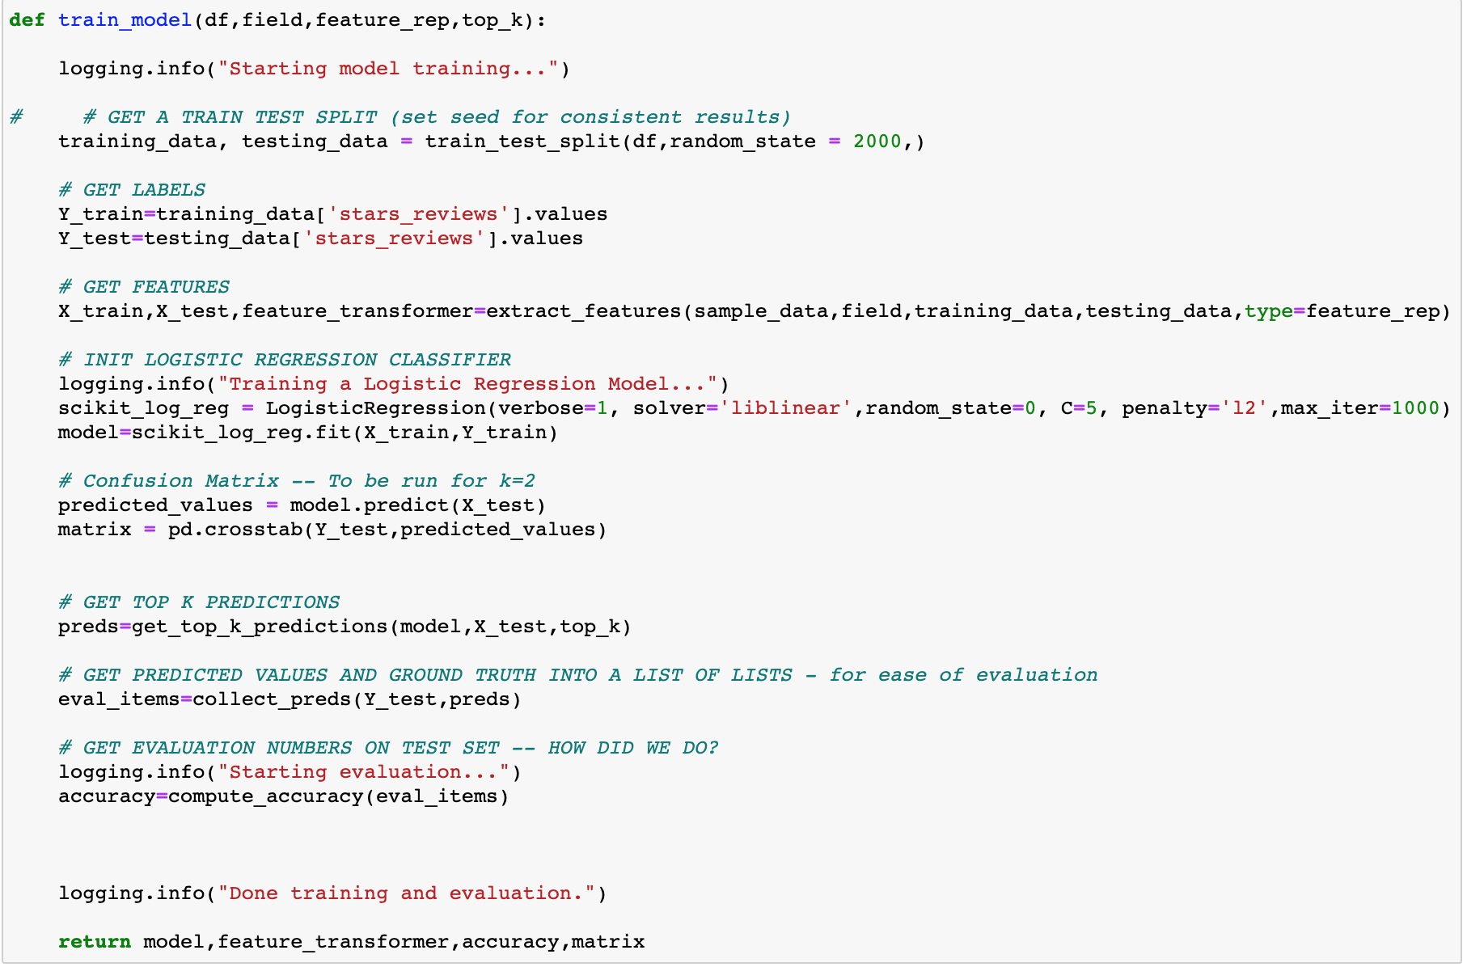
LOGISTIC REGRESSION - THREE MAJOR STEPS OVERALL
EXTRACT FEATURES
TRAIN MODEL
Notes:
https://kavita-ganesan.com/news-classifier-with-logistic-regression-in-python/

Slide 26
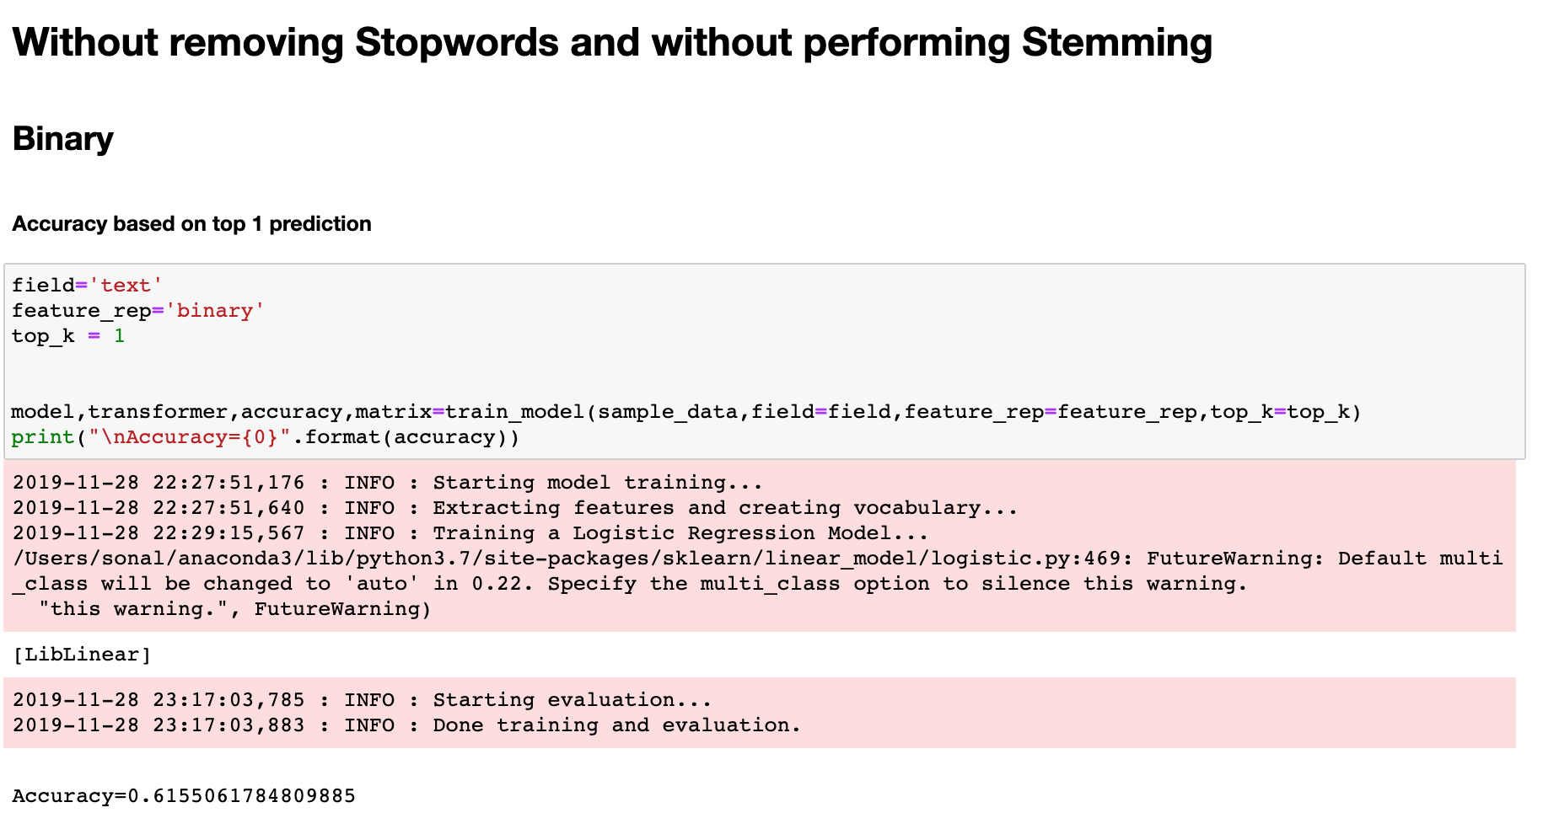
LOGISTIC REGRESSION - THREE MAJOR STEPS OVERALL
SPECIFY PARAMETERS AND MAKE PREDICTIONS WITH PARTICULAR KIND OF MODEL

Slide 27
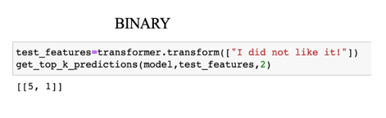
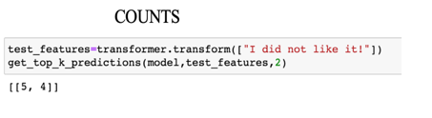
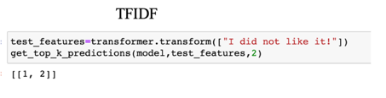
TESTING THE MODELS ON A TEXT

Slide 28
COMPARISON OF RESULTS
METHOD | STOPWORDS REMOVAL AND STEMMING | VECTORIZER | ACCURACY
Unigram | N | Binary | 58.93%
 |  | Counts | 58.99%
 |  | TFIDF | 62.55%
Unigram | Y | Binary | 58.48%
 |  | Counts | 58.42%
 |  | TFIDF | 61.59%
Unigram and Bigram | N | Binary | 61.55%
 |  | Counts | 61.60%
 |  | TFIDF | 65.19%
Unigram and Bigram | Y | Binary | 61.39%
 |  | Counts | 61.35%
 |  | TFIDF | 63.86%
ACCURACY (TOP 2 PREDICTIONS)
84.08%
84.12%
88.13%
83.22%
83.41%
87.20%
86.54%
86.67%
90.23%
86.38%
86.40%
89.10%

Slide 29
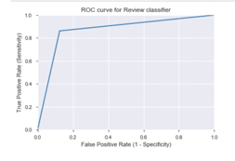
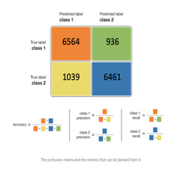

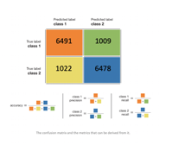
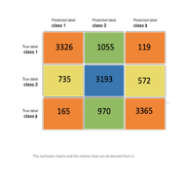
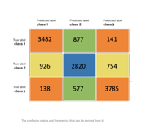
RANDOM FOREST AND SVM MODELS
METHOD | VECTORIZER | ACCURACY (Approach 1)
Random Forest | BOW | 77.72%
 | TFIDF | 78.04%
SVM | BOW | 87.45%
 | TFIDF | 86.43%
Random Forest | BOW | 78.30%
 | TFIDF | 78.52%
SVM | BOW | 86.68%
 | TFIDF | 86.46%
ACCURACY (Approach 2)
61.91%
61.38%
74.25%
73.21%
61.24%
61.64%
74.71%
74.65%

Slide 30
TESTING THE MODELS ON A TEXT
RANDOM FOREST
SUPPORT VECTOR MACHINE

Slide 31
LEARNINGS
TF-IDF based weighting performs better than Binary, Count based schemes
Logistic Regression > SVM > Random Forest
We can do feature engineering using N gram sequence as the richer the text field, the better the overall performance of the classifier
Next step, creating new text fields by adding the content from ‘Tips’
Accuracy is not the only benchmark and context plays a vital role
The algorithm cannot understand the tone of the review and detect human emotions like irony, sarcasm, jokes or exaggerations and failure to recognize these can skew the results
Businesses can use this methodology to predict rating as well as sentiment in real-time and undertake relevant actions to improve customer service

Slide 32
TIME FOR A DEMO
http://nlp.sonal.cc/?
Notes:
http://nlp.sonal.cc/?

Slide 33
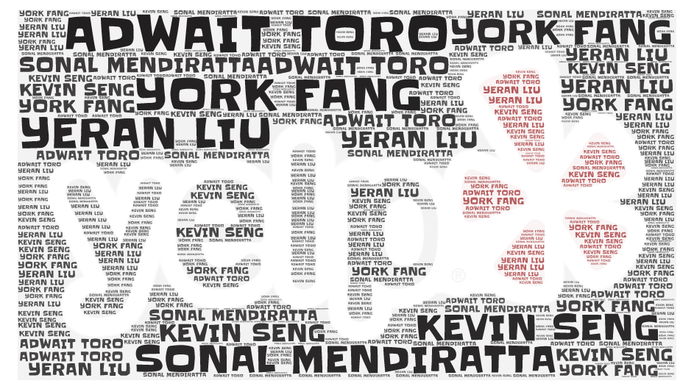

Slide 34
APPENDIX

Slide 35
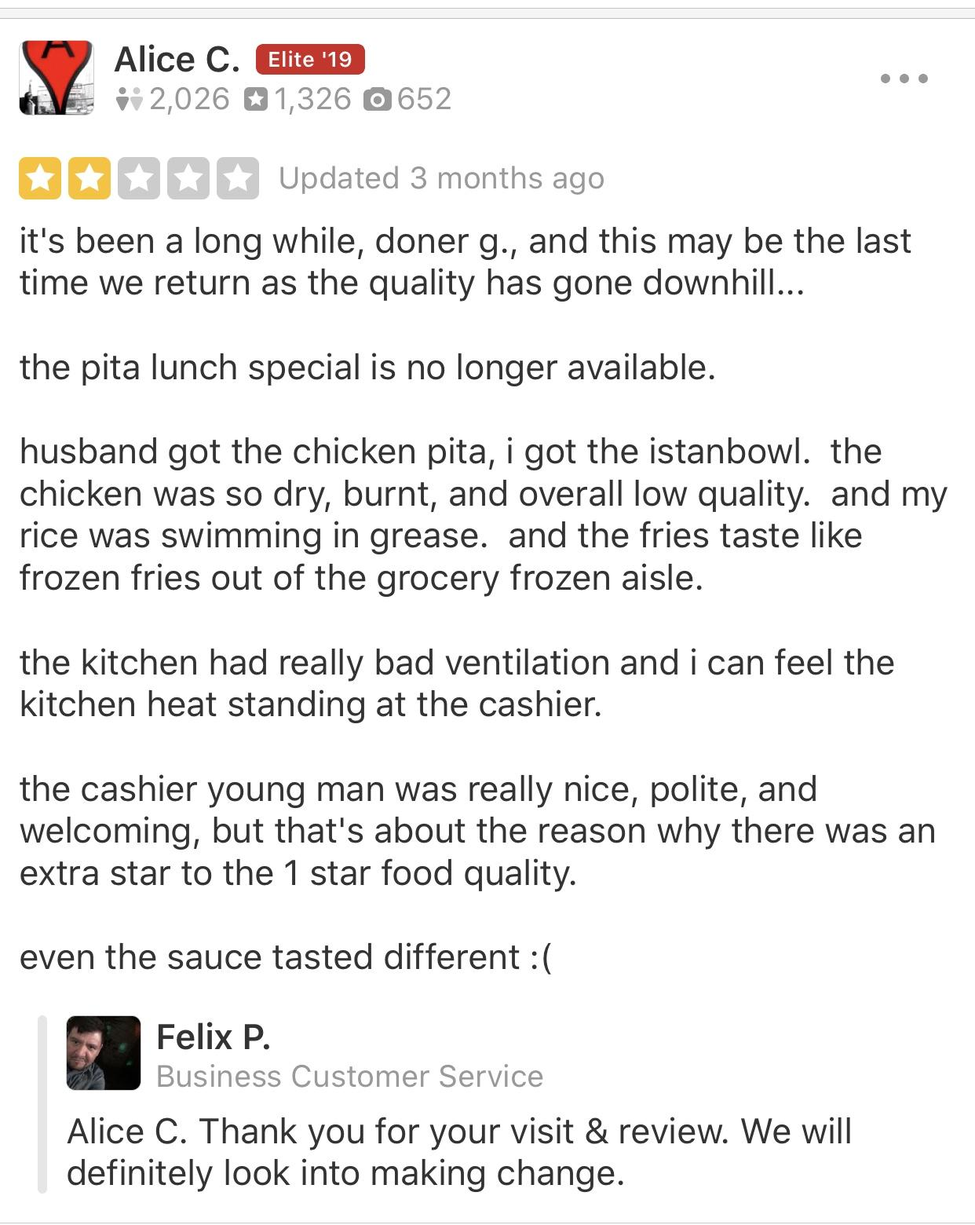
APPENDIX 1: INSPIRATION
A negative review, especially from an elite user can result into lost opportunity for a business
Businesses usually respond to negative reviews after a certain time but by then the damage is already done
Idea – real time prediction of rating while customer is typing the review so that action can be undertaken even before the review is live!
Potential to greatly improve customer service and reduce risk of lost business
Notes:
Our inspiration of predicting star ratings based on sentiment of a review

Slide 36
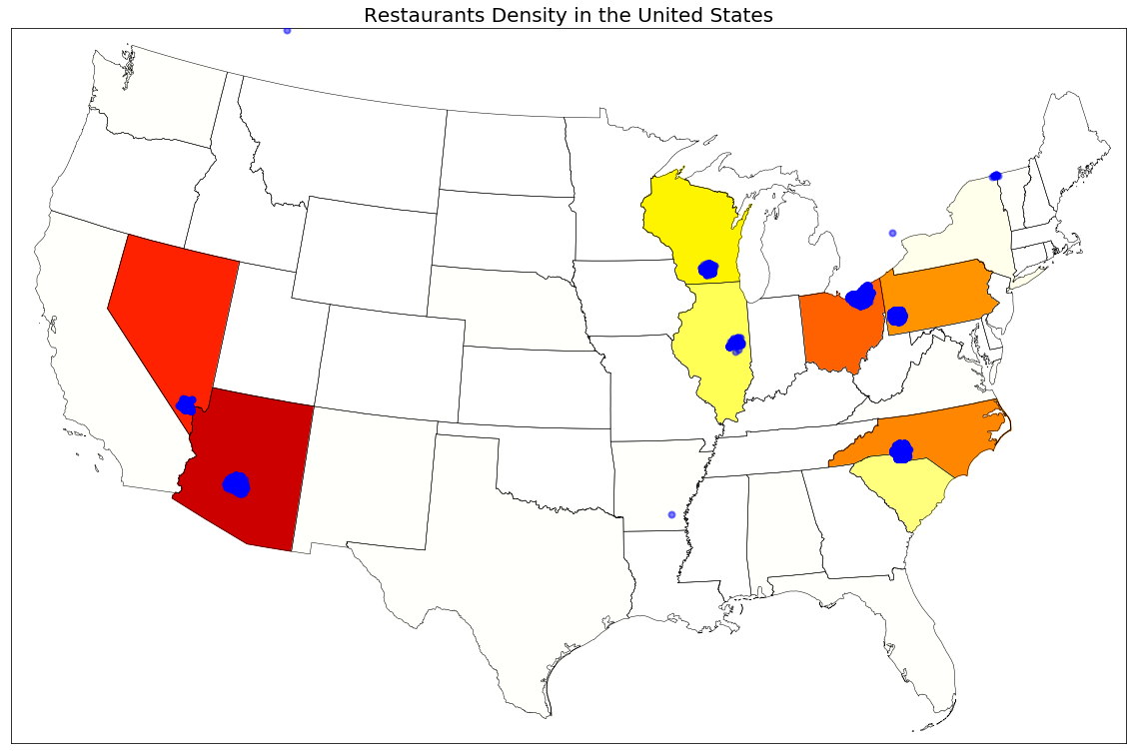
APPENDIX 2: RESTAURANT DENSITY

Slide 37
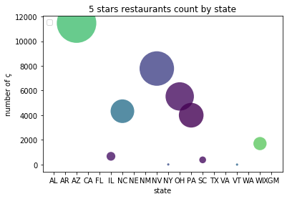
APPENDIX 3: RATING DISTRIBUTION
STAR RATINGS DISTRIBUTION
BY STATE
Arizona has the highest number of restaurants with 5 star ratings
Notes:
Among those restaurant, AZ has the most restaurants and most number of 5 star ratings count

Slide 38
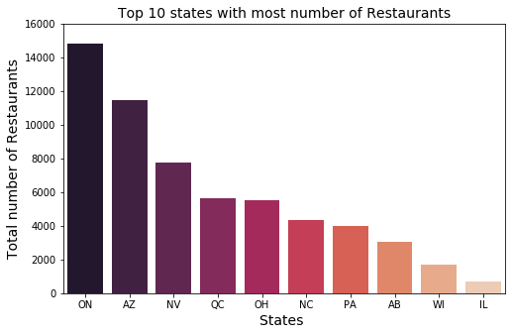
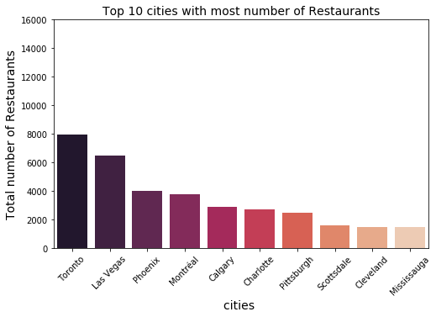
APPENDIX 4: RESTAURANT BREAKDOWN
TOP 10 STATES
WITH MOST RESTAURANTS
Ontario has the most number of restaurants
TOP 10 CITIES
WITH MOST RESTAURANTS
Toronto has the most number of restaurants
Notes:
then we can look at even more detailed that we break down the restaurant distribution from the overall dataset to USA only, from the overall dataset, we can tell that Ontario state in canada has the most of restaurant and followed by Arizona and then Nevada from USA, in the city side, the city Toronto has the most of restaurants then followed by Las vegas, in the United States, Top 3 number of restaurant of states are AZ, NV and ohio, top 3 cities are Las Vegas, phoenix and Charlotte

Slide 39
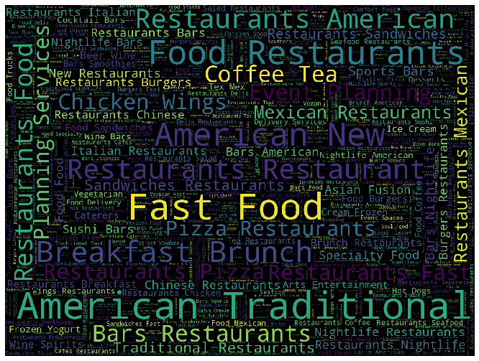
APPENDIX 5: Top Restaurant Categories

Slide 40




APPENDIX 6: PREDICTING THE RATING FROM A REVIEW
Feature Representation
Feature Weighting
Building the Classifier
Prediction
Used reviews as source of features
Ran separate iterations after removing stop words and performing stemming on the text
Feature engineering using N gram sequences
Binary – if a word is present in the document, the weight is ‘1’ else ‘0’
Count – weights equal to number of occurrences of a word
TFIDF – words that are unique to a document would have higher weights compared to the words that are used commonly across documents
Independent variables – The features created in the previous step
Dependent variable – Rating given by the user
Logistic regression model
Multi - classification problem as the categories range from 1 through 5
Predicted ratings on test data using the model
Evaluation of performance through accuracy and multi-class confusion matrix
Prediction on new text for validation
Sample size – 200K records (5% of the overall data) which was further divided into Train and Test in the ratio 75:25
Notes:
Term frequency (tf) is basically the output of the BoW model. For a specific document, it determines how important a word is by looking at how frequently it appears in the document. Term frequency measures the local importance of the word. If a word appears a lot of times, then the word must be important. For example, if our document is “I am a cat lover. I have a cat named Steve. I feed a cat outside my room regularly,” we see that the words with the highest frequency are I, a, and cat. This agrees with our intuition that high term frequency = higher importance since the document is all about my fascination with cats.
The second component of tf-idf is inverse document frequency (idf). For a word to be considered a signature word of a document, it shouldn’t appear that often in the other documents. Thus, a signature word’s document frequency must be low, meaning its inverse document frequency must be high.
.
https://web.stanford.edu/~jurafsky/slp3/5.pdf

Slide 41

APPENDIX 7: CONFUSION MATRIX – UNIGRAM
BINARY
COUNTS
TFIDF
 | 1 | 2 | 3 | 4 | 5
1 | 4408 | 951 | 412 | 209 | 275
2 | 1208 | 1412 | 1260 | 571 | 296
3 | 439 | 976 | 2424 | 2320 | 879
4 | 176 | 303 | 1465 | 6027 | 5695
5 | 117 | 123 | 409 | 3483 | 16683
 | 1 | 2 | 3 | 4 | 5
1 | 4390 | 951 | 419 | 223 | 272
2 | 1239 | 1403 | 1265 | 546 | 294
3 | 460 | 963 | 2463 | 2290 | 862
4 | 187 | 310 | 1443 | 5971 | 5755
5 | 134 | 115 | 398 | 3412 | 16756
 | 1 | 2 | 3 | 4 | 5
1 | 4831 | 789 | 300 | 142 | 193
2 | 1347 | 1421 | 1277 | 479 | 223
3 | 440 | 760 | 2604 | 2530 | 704
4 | 144 | 146 | 1055 | 6671 | 5650
5 | 96 | 47 | 207 | 3137 | 17328
WITHOUT STOP WORDS REMOVAL AND STEMMING
 | 1 | 2 | 3 | 4 | 5
1 | 4394 | 905 | 406 | 238 | 312
2 | 1237 | 1343 | 1221 | 591 | 355
3 | 469 | 940 | 2356 | 2345 | 928
4 | 188 | 303 | 1453 | 5914 | 5808
5 | 115 | 117 | 432 | 3443 | 16708
 | 1 | 2 | 3 | 4 | 5
1 | 4364 | 922 | 405 | 248 | 316
2 | 1256 | 1332 | 1218 | 583 | 358
3 | 472 | 963 | 2355 | 2279 | 969
4 | 204 | 303 | 1407 | 5869 | 5883
5 | 131 | 131 | 423 | 3367 | 16763
 | 1 | 2 | 3 | 4 | 5
1 | 4780 | 741 | 328 | 171 | 235
2 | 1339 | 1300 | 1258 | 535 | 315
3 | 458 | 745 | 2469 | 2545 | 821
4 | 155 | 158 | 1072 | 6533 | 5748
5 | 112 | 53 | 229 | 3152 | 17270
WITH STOP WORDS REMOVAL AND STEMMING
Yelp Ratings range from 1 through 5. Here, Rows are Actual Values while Columns are Predicted Values

Slide 42
APPENDIX 8: CONFUSION MATRIX – UNIGRAM AND BIGRAM
BINARY
COUNTS
TFIDF
 | 1 | 2 | 3 | 4 | 5
1 | 4684 | 918 | 328 | 151 | 174
2 | 1196 | 1594 | 1284 | 487 | 186
3 | 379 | 938 | 2778 | 2262 | 681
4 | 95 | 209 | 1376 | 6589 | 5397
5 | 58 | 41 | 303 | 3731 | 16682
 | 1 | 2 | 3 | 4 | 5
1 | 4651 | 935 | 329 | 167 | 173
2 | 1223 | 1613 | 1279 | 448 | 184
3 | 364 | 969 | 2798 | 2245 | 662
4 | 95 | 208 | 1359 | 6578 | 5426
5 | 52 | 38 | 281 | 3726 | 16718
 | 1 | 2 | 3 | 4 | 5
1 | 4995 | 746 | 258 | 99 | 157
2 | 1304 | 1583 | 1284 | 401 | 175
3 | 380 | 739 | 2984 | 2335 | 600
4 | 101 | 87 | 1019 | 7097 | 5362
5 | 50 | 12 | 136 | 3033 | 17584
WITHOUT STOP WORDS REMOVAL AND STEMMING
 | 1 | 2 | 3 | 4 | 5
1 | 4677 | 834 | 325 | 186 | 233
2 | 1237 | 1477 | 1228 | 536 | 269
3 | 396 | 829 | 2649 | 2395 | 769
4 | 131 | 176 | 1270 | 6514 | 5575
5 | 74 | 45 | 233 | 3534 | 16929
 | 1 | 2 | 3 | 4 | 5
1 | 4663 | 824 | 331 | 202 | 235
2 | 1242 | 1499 | 1217 | 528 | 261
3 | 408 | 839 | 2596 | 2408 | 787
4 | 124 | 179 | 1280 | 6493 | 5590
5 | 70 | 53 | 262 | 3458 | 16972
 | 1 | 2 | 3 | 4 | 5
1 | 4898 | 733 | 280 | 147 | 197
2 | 1313 | 1435 | 1288 | 477 | 234
3 | 433 | 657 | 2754 | 2490 | 704
4 | 136 | 99 | 1001 | 6919 | 5511
5 | 80 | 26 | 157 | 3013 | 17539
WITH STOP WORDS REMOVAL AND STEMMING
Yelp Ratings range from 1 through 5. Here, Rows are Actual Values while Columns are Predicted Values

Slide 43
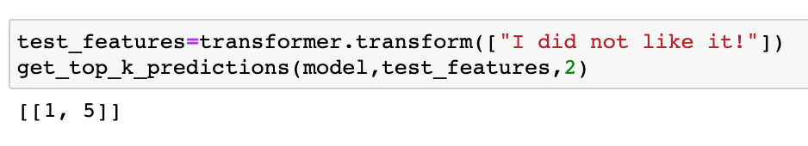
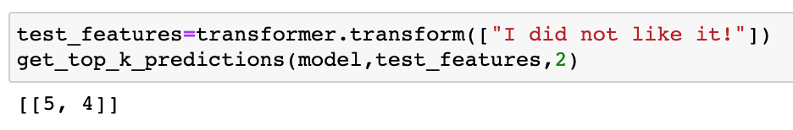
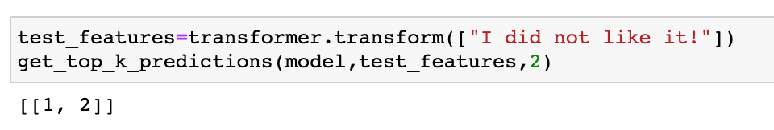
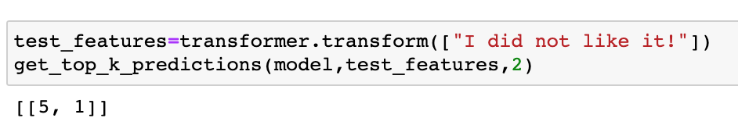
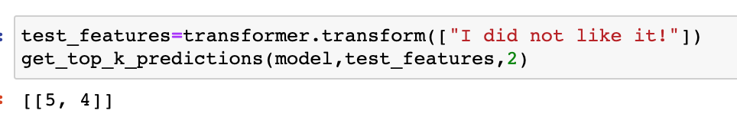
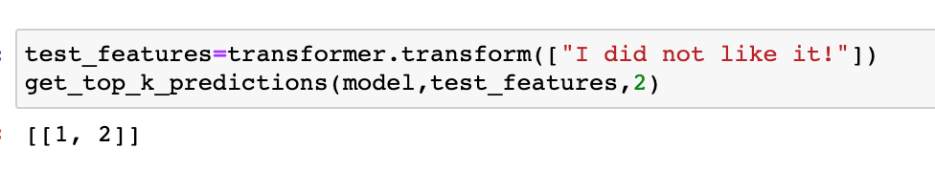
APPENDIX 9: MODEL UNIGRAM
COUNTS
TFIDF
BINARY
WITHOUT STOP WORDS REMOVAL AND STEMMING
WITH STOP WORDS REMOVAL AND STEMMING

Slide 44
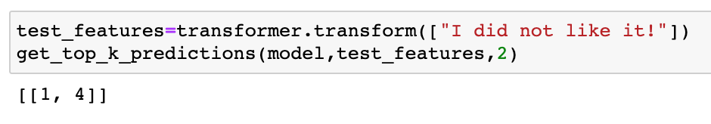
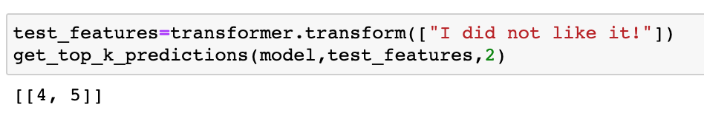



APPENDIX 10: MODEL UNIGRAM AND BIGRAM
COUNTS
TFIDF
BINARY
WITHOUT STOP WORDS REMOVAL AND STEMMING
WITH STOP WORDS REMOVAL AND STEMMING

Slide 45

APPENDIX 11: CONFUSION MATRIX – RANDOM FOREST: 1 & 0

Slide 46

APPENDIX 12: CONFUSION MATRIX – RANDOM FOREST : 1, -1 & 0

Slide 47

APPENDIX 13: CONFUSION MATRIX – SVM: 1 & 0

Slide 48

APPENDIX 14: CONFUSION MATRIX – SVM: 1, -1 & 0

